Slide 1

Food made from the Heart
Prepared by:
Terry Chew Seow Peng
Tan Shao Bin
Ng Chi Hui
Yuki Toh Khai Si
Prepared for:
Neo Garden
Disclaimer: This report is specially prepared for the exclusive use of Neo Garden on 12 April 2021. Any unauthorised reproduction of this material is strictly prohibited.

Slide 2
Executive Summary
This report proposes the collaboration between Neo Garden and The Majurity Trust for the “Warm Meals, Warm Hearts” programme, outlining the cause, execution plan, timeline and potential benefits for involved stakeholders. Primary (surveys) and secondary (online) research were used to ascertain key issues within our target community and support the creation of our execution plan.
Situational Analysis
The Majurity Trust is a philanthropic organization that catalyzes collaboration with partners to build a thriving and sustainable community for Singaporeans. The group is proposing to set up a community kitchen programme (“Warm Meals, Warm Heart”) to rekindle the Kampong Spirit and alleviate food insecurity for underserved communities while providing a variety of options that are fresh and nutritious. Through surveys, The Majurity Trust confirmed that the pain points of the selected beneficiaries (Senja Road rental flats residents) were aligned with its key motivations. Online research identified key success factors of various local community/soup kitchens, such as the “Pay What You Can” initiative and the concept of food and physical spaces as a key tool for community bonding, which will be adopted by the programme.
Proposed Partner
The Majurity Trust is proposing a collaboration with Neo Garden to leverage on its industry connections, culinary expertise and kitchen design experience. Neo Garden will benefit from higher levels of community engagement, Economic, Social & Governance participation and positive marketing effects.
Proposed Action Plan
The proposed programme is expected to launch within 7 months to cater to the underserved food insecure community and foster stronger bonds. Awareness will be raised through door-to-door promotions and Facebook/Instagram updates. The Majurity Trust has also proposed sustainability and expansion plans. Evaluation metrics such as attendance rate and volunteer sign-up rates will be collected through pre and post surveys that will assess the social impact.
Conclusion
Singapore as a wealthy nation has immense potential to eliminate food insecurity and become a more homely and liveable place. Together with Neo Garden’s expertise, the “Warm Meal, Warm Hearts” programme will not only provide gains for Neo Garden in terms of corporate social responsibility but also for the greater good of Singapore. Join us today to make Singapore a better place!

Slide 3
Table of Contents
01
EVALUATION 5.1 Cost Benefit Analysis 5.2 Evaluation Metrics 5.3 Long Term Plans 5.4 Potential Challenges | 17 18 19 20
CONCLUSION | 21
BIBLIOGRAPHY | 22
APPENDIX | 25
INTRODUCTION 1.1 Company Background | 4
SITUATIONAL ANALYSIS 2.1 Motivations behind Initiatives 2.2 Proposed Beneficiaries & Goals 2.3 Secondary Research Key Success Factors 2.4 Primary Research Key Findings | 5 7 9 10
REASONS FOR COLLABORATION 3.1 Collaboration Benefits for Neo Garden | 11
EXECUTION PLAN 4.1 Stakeholders’ Roles 4.2 Proposed Timeline 4.3 Proposed Marketing Efforts 4.4 Proposed Execution Plan 4.5 Proposed Budget | 12 13 14 1516
05
02
06
03
07
04
08

Slide 4

1.0 Introduction
“Our Vision Is A Thriving And Sustainable Community For All In Singapore”
Introduction
The following report is a proposal by The Majurity Trust (TMT) to Neo Garden (NG) for an opportunity to collaborate on an initiative in rekindling Kampung Spirit among Singaporeans. TMT hopes to bring Singaporeans together through a community kitchen initiative supported by Neo Garden.
The report will first identify TMT’s motivations behind the project, followed by an analysis of successful case studies of community kitchens implementation around Singapore. Thereafter, survey and short chats are conducted to determine the key issues and sentiments of the chosen service users. Reasons for choosing Neo Garden will also be highlighted. Following which, an action plan will be proposed, with the respective timeline and budget plan highlighted. Lastly, key social impact metrics that will be used to highlight the success of the plan will be discussed.
About The Majurity Trust
TMT is a philanthropic organisation established in 2018 to rally support of like-minded peers in the advancing of welfare of all in Singapore. TMT’s main mission is to be the catalyst of collaboration and creativity for the common good of all Singaporeans. The three key arms of TMT are gleaning, giving and galvanising. As part of TMT galvanising arm, TMT would like to facilitate corporate partners like Neo Garden to meet the needs in the community.
Introduction
Situational Analysis
Reasons for Collaboration
Execution Plan
Evaluation
Conclusion

Slide 5
2.0 Situational Analysis – Motivations behind Initiatives
1. Lack of Kampung Spirit
“Kampung Spirit” refers to a strong sense of belonging, of camaraderie, of community. It’s a value, not an object of heritage that is relevant only in the past (Chia, 2021). Due to the changing social structures of modern Singapore and as Singapore continues to prosper into a globalised and digitised city, Singaporeans are found to have increasingly weaker relationships with their community.
Reason 1: Lack of Time/Preference for Privacy
Singaporeans are interacting less with their neighbours, often because of a lack of time or a privacy preference. With smartphones, we prefer to concentrate on our smartphones rather than people around us (Chia, 2018). The “open door” policy in kampongs encourages trust, frequent communication, and gatherings take place. However, such culture does not occur in HDBs as Singaporeans are increasingly becoming more private.
Reason 2: Changing Structure of Neighbourhoods
Another notable reason for the weakening of this “neighbourliness” is the structure of the neighbourhood (Lagman, 2019). Common spaces like void decks that have originally been created to encourage residents to interact informally, have largely been unsuccessful (Au-Yong, 2017). Void decks are shared, wide open and reserved Singaporeans are unlikely to have interaction in void decks spontaneously. Strict rules that ensure that public spaces do not generate noise and activity such as the banning of ball games further stifles interaction (Sam Jo, 2016). Currently, the structure of HDBs unlike kampongs lacks such avenue and opportunities for social interaction (Liang, 2019). These factors result in residents not having a shared sense of belongingness to their neighbourhood. Our programme hopes to intentionally create a safe space, which serves as an area for residents to mingle every other Saturday. A community space for residents to form meaningful connections, through the idea of collective idling (Chua, 1994).
Introduction
Situational Analysis
Reasons for Collaboration
Execution Plan
Evaluation
Conclusion

Slide 6
2.0 Situational Analysis – Motivations behind Initiatives
2. Food Insecurity among Underserved Communities
Despite Singapore national reputation as an affluent nation and is known as a cheap food paradise, however, some 4.1% of Singaporeans face moderate-to-severe food insecurity (Tong, Yip, Tiah, 2020a). One of the primary reason is the rising food cost in Singapore squeezing household budgets. A study shows that more than half of the surveyed who experienced severe food insecurity received infrequent or no support at all (Alexander, 2020). Food insecurity continues to persist even with 125 food support organizations serving food-insecure due to misalignment of food support where some areas being underserved while others being over-served. Currently, there is no central database for food charity organizations in Singapore to know who’s getting help and who isn’t (Alexander, 2020). The lack of an integrated system results in duplicated aid in overserved areas while underserved Singaporeans remain hungry. Thus, the programme hopes to provide food expense relief and alleviate food insecurity for these Singaporeans living in these underserved rental flats.
3. Gaps in Social Provision
Lack of Freshness, Nutrition & Variety of Food
Most food rations pack provided by food support organisations lack variety, freshness and nutrition. This is because, many food support organisations rely on donated food items to give out to beneficiaries. Transporting fresh food has also been a significant issue faced when giving out food rations. This results in food rations containing the same kinds of non-perishables with a long shelf-life such as instant noodles and a variety of canned foods. Beneficiaries are unable to personalise their ration and packed food, resulting in a mismatch of the needs of beneficiaries and the food distributed. This leads to a pile-up of rice, instant noodles, biscuits, and canned sardines and baked beans which are eventually forgotten or discarded causing food wastage. (Tong, Yip, Tiah, 2020b).
Similarly, residents who frequently received packet meals from food support organizations mentioned the lack of variety and nutrition as they have been having the same type of food for years. The food is frequently cooked the same way to ensure efficiency of cooking. Due to the stigmatised food aid environment, beneficiaries are unable to provide feedback as there’s a perceived notion that they are the receiving end and should not complain about what’s provided (Tong, 2020a).
Introduction
Situational Analysis
Reasons for Collaboration
Execution Plan
Evaluation
Conclusion

Slide 7
2.0 Situational Analysis – Proposed Beneficiaries & Goals
Brief Idea of Plan
TMT has proposed the idea of a community kitchen foster space for the community to come together to bond. At the same time, ensuring the food security for the proposed community.
Goal 1: Building a community
Traditionally, basic needs of humans consist of food, water, and shelter. Interpersonal food behaviors, such as food sharing and food offering, are associated with closeness between people and thought to facilitate the formation and strengthening of social bonds (Gregersen & Gillath, 2020). Our programme aims to bring Senja Road residents together through cooking and sharing of food in a community kitchen.
In a multiracial nation like Singapore, food will be an excellent method to further promote the sharing of cultures among residents with different backgrounds living in the same estate. Social cohesion is fostered through these interactions, fostering a ‘Kampong Spirit’.
Proposed Beneficiaries
Residents staying in rental flats along Senja Road, Blocks 632A and 632B will be the recipients of the first run of the community kitchen as it has one of the few community gardens in Singapore which we hope to utilise in our solution. From the team’s primary research, Senja Road low-income community is not widely served in Singapore as compared to other areas like Jalan Kukoh. By targeting an area that has not been well reached, the impact on the community would be greater compared to somewhere that’s overserved as the residents are most likely the ones who are food insecure.
Goal 2: Providing Warm Meals for Food Insecure Residents
Our programme aims to target families living under the HDB Rental Scheme along Senja Road, Blocks 632A and 632B. Families living under the scheme has total household gross income not exceeding $1,500 every month. We hope to assist the underprivileged families through providing warm meals and minimizing their struggles of sourcing food for their family.
Introduction
Situational Analysis
Reasons for Collaboration
Execution Plan
Evaluation
Conclusion

Slide 8
2.0 Situational Analysis – Proposed Beneficiaries & Goals
Goal 3: Supply Variety of Nutritious Food
Goal 4: Cultivating Culinary Skills
Motivations
Goals
Good intentions of food assistance groups across Singapore sometimes fall short of meeting needs of beneficiaries. Through the community cooking sessions, we strive to help residents establish a say in the classifications of food they will be consuming. In this trial programme, we will be targeting a smaller social group and it enables a higher customizability for special needs such as low sodium, low sugar or soft diets. As the ingredients and menus are subjected to the daily fresh produce and expertise from Neo Garden, we look forward to the variety of delicious meals residents will be receiving.
We recognize the importance of sustainable help and hence wish to impart lifelong skills to residents. Through the utilization of community kitchen, we provide a platform for residents to pick up basic culinary skills. The skills will extend beyond just preparing food, but also in budgeting and eating healthy through helping residents to learn about nutrition guidelines and make healthier food choices.
Acquiring basic culinary skills could be beneficial for residents passionate or currently employed in the Food and Beverage (F&B) industry. We hope to turn cooking into a creative outlet for residents, especially young residents who are discovering their career paths. We aim to motivate them to pick up a lifelong hobby they would have otherwise never imagined.
Lack of Kampung Spirit
Goal 1: Building a Community
Food Insecurity among Underserved Communities
Goal 2:
Providing Warm Meals for Food Insecure Residents
Gaps in Social Provision
Goal 3: Supplying Variety of Nutritious Food
Introduction
Situational Analysis
Reasons for Collaboration
Execution Plan
Evaluation
Conclusion

Slide 9
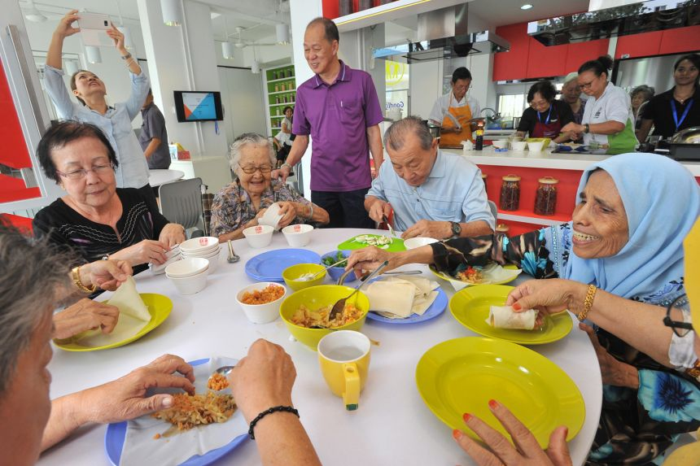
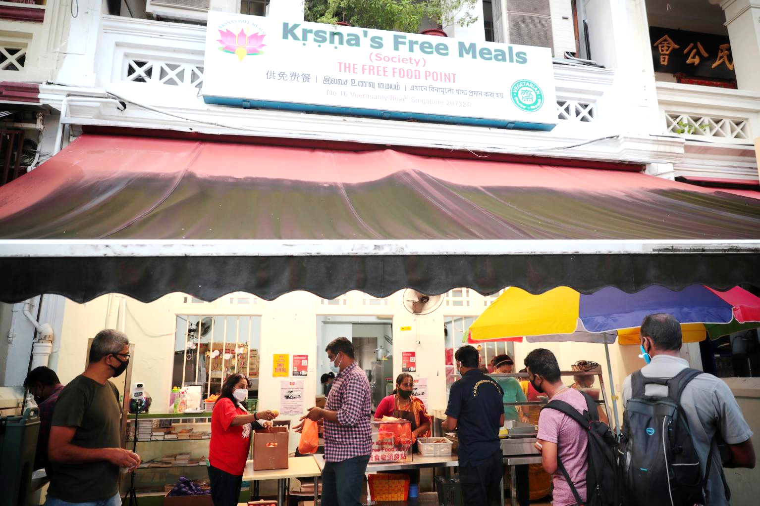
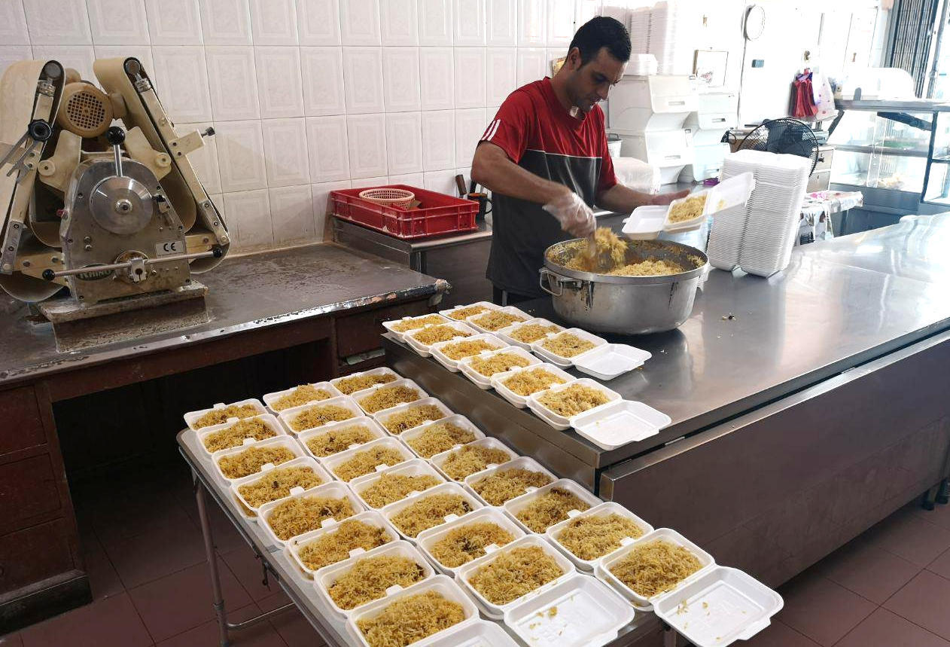
2.0 Situational Analysis – Secondary Research Key Success Factors
We researched on three different initiatives across Singapore. One strives to bond seniors through food, one strives to encourage paying kindness forward, and the last one strives to alleviate hunger of underprivileged social groups. We can learn from their success and integrate their goals to better serve beneficiaries in our programme.
GoodLife! Makan at Marine Terrace
Krsna's Free Meals
Free Food For All
Figure 2.2 – Seniors at GoodLife! Makan
Source: The Straits Time
Figure 2.3 – Workers collecting meals
Source: The Straits Time
Figure 2.4 – Food being prepared
Source: Ricemedia
Goodlife! Makan community kitchen was started in January 2016 by Montfort Cares at a void deck. The initiative encourages stay-alone seniors to come out of their homes to participate in cooking for their neighbors and friends. The popular gathering spot for seniors has helped boost physical and mental wellbeing of seniors and foster social cohesion among seniors. This case study highlights the importance of physical spaces and food as a catalyst for social cohesion.
Krsna’s Free Meals serves free vegetarian breakfast and lunch to 1,000 people daily. Little India was chosen as the area of service as there are many migrant workers gathering with no food aid. The initiative believes that food can be free and delicious. Beneficiaries are encouraged to make small donations of any amount or volunteer to give back to the community. This case study highlights the “Give it Back” movement which gave beneficiaries a sense of dignity through contribution to their meals.
Free Food For All (FFFA) was started in 2014 by Nizar, a retired businessman. It serves 1,000 – 2,000 beneficiaries each month. It collaborates with caterers and kitchens to prepare Halal food for beneficiaries and focuses on food quality. FFFA positions itself as a project for the Community, by the Community. This case study highlights the underlying desire to rekindle kampong spirit through fostering strong ties between neighbors and the community.
Introduction
Situational Analysis
Reasons for Collaboration
Execution Plan
Evaluation
Conclusion

Slide 10
2.0 Situational Analysis – Primary Research Key Findings
We conducted a short multiple-choice questions survey and short chats with residents living at Senja Road Block 632A and Block 632B. Based on the survey, we gathered key insights on the amount and type of food aid that the residents are currently receiving. The survey highlighted that this is an underserved area.
Respondents’ Sentiments on Establishing a Community Kitchen in their estate
“Community Cooked Meals Are Cost Effective”
Residents found that purchasing of fresh produce and food ingredients in bulk to prepare meals are cheaper and could benefit more residents and their families. Some residents found it wasteful and expensive to cook for themselves as ingredients are always sold in a portion bigger than their needs.
47%
Of respondents’ food aid packages are dried goods
“Willing And Excited To Interact With Neighbors”
Residents expressed interests to expand their social circle and find activities to utilise their time. Majority of respondents who felt this way are retired senior citizens living alone or spending their time alone at home during the day while their family member's work.
62%
Of respondents has never receive cooked food or meals from charities
“Will Participate To Cook Better For Their Children”
Some residents hope to pick up new recipes through the programme to experiment and whip out nutritious meals for their growing children.
Figure 2.1 : Response from Survey
Introduction
Situational Analysis
Reasons for Collaboration
Execution Plan
Evaluation
Conclusion

Slide 11
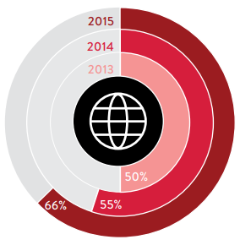
3.0 Reasons for Collaboration
Higher Levels of Community Engagement
With the original format of learning and preparing warm meals, participants stand to gain long term benefits as they can better provide for themselves and become more employable. Through continued participation, Neo Garden engages the community at a higher level on top of its other initiatives (e.g., “Neo Seed Fund” and “Begin with Love).
Collaboration Benefits for Neo Garden
Positive Marketing Effect
Neo Garden can build goodwill with participants through continued participation. As we expand, this effect and the resultant positive marketing will follow too. Since consumers lean towards corporate citizenship (Fig 3.1), the accumulated goodwill represents a competitive advantage over Neo Garden’s competitors.
Fig 3.1 Consumers willing to pay more for sustainable brands
Source: Nielsen 2015 Global Corporate Sustainability Report
Rising Trend of Environmental, Social and Governance (ESG) Investing
ESG investing is a rising investment trend (Fig 3.2) and has become a priority for corporations. Neo Garden will enjoy the benefits of ESG participation and therefore generate value as investors find the company more attractive. This fulfils the duty of shareholder wealth maximization and increases the company’s growth potential.
ESG isn’t just a nice thing to do. It is becoming a critical element in gaining market share, engaging employees and raising capital.
Fig 3.2 Bain & Co’s views on ESG
Source: Bain & Company, 2021
Introduction
Situational Analysis
Reasons for Collaboration
Execution Plan
Evaluation
Conclusion
Notes:
https://www.forbes.com/sites/theyec/2019/06/10/why-giving-back-increases-brand-loyalty/?sh=60aa4fd370d2
https://www.bain.com/insights/esg-investing-global-private-equity-report-2021/?utm_source=linkedin_company&utm_medium=social_organic&utm_content=4548221592&utm_campaign=OS-PE-PEG-GLOBALPRIVATEEQUITYREPORT-2021-03&linkId=112742648

Slide 12


4.0 Execution Plan – Stakeholders’ Roles
Neo Garden will provide raw ingredients used in meal preparations. This ensures food quality and safety with Neo Garden’s stringent standards. It also removes the cost barrier that may discourage participation.
Neo Garden will also provide its culinary expertise and kitchen interior design expertise. Neo Garden’s certified chefs will ensure that participants learn professional and safe food preparation skills. In addition, to maximize the efficiency of TMT’s kitchen funding, we hope to leverage on Neo Garden’s experience in designing professional kitchens.
TMT’s will fund the community kitchen, covering all related expenses including essential facilities and appliances ($4,500), with funds from donations and our built-up reserves.
We will also lay the groundwork for sustainable operations by leveraging on our existing charity connections to explore improvements and push the programme towards longer term sustainable operations.
Cashew Zone 4 Residents’ Committee (RC) will maintain social order by acting as crowd control during the actual programme and tending to residents with special needs, such as the elderly or handicapped individuals.
RC staff/volunteers will also facilitate meal distribution with customized portioning to reduce waste and minimize contamination arising from self-service.
Introduction
Situational Analysis
Reasons for Collaboration
Execution Plan
Evaluation
Conclusion

Slide 13
4.0 Execution Plan – Proposed Timeline
Start of Kitchen Construction
Start of Marketing Efforts
Primary Construction
Review of Operations
Collation of Post-Survey
Post
Completion of Kitchen Construction
End of Construction
APRIL
MAY
JUNE
JULY
AUGUST
SEPTEMBER
OCTOBER
Final Planning Stage
Details of the constructions with contractors
List of equipment with the suppliers
Obtain permission from relevant authorities
Secondary Construction
Kitchen Equipment Installation
Launch
Opening of Community Kitchen
Fig 4.1 “Warm Meals, Warm Hearts” Timeline
In April, TMT will enter the final planning phase, where we confirm the construction details with contractors, finalize the list of equipment with suppliers and obtain permission from authorities.
In May, kitchen construction and marketing efforts will kick off. The construction is estimated to be fully functional by July.
In August, TMT launch the community kitchen alongside the programme. After 2 months, we will conduct a post-survey for further reviews.
The above constitutes the Initial Phase of our long-term plan. As the programme grows and stabilizes, we will eventually train sufficient Resident Committee staff and participants to take over further operations in the Independent Phase. In the even longer term ahead, we look to expand the programme to other residential areas across Singapore it gathers enough momentum in the Expansion Phase.
Current
Initial Phase
Programme Implementation @ Senja Road
Future
Independent Phase
Participants and Resident Committee takes over
Future
Expansion Phase
Expansion to other residential areas
Fig 4.2 “Warm Meals, Warm Hearts” Future Phases
Introduction
Situational Analysis
Reasons for Collaboration
Execution Plan
Evaluation
Conclusion

Slide 14
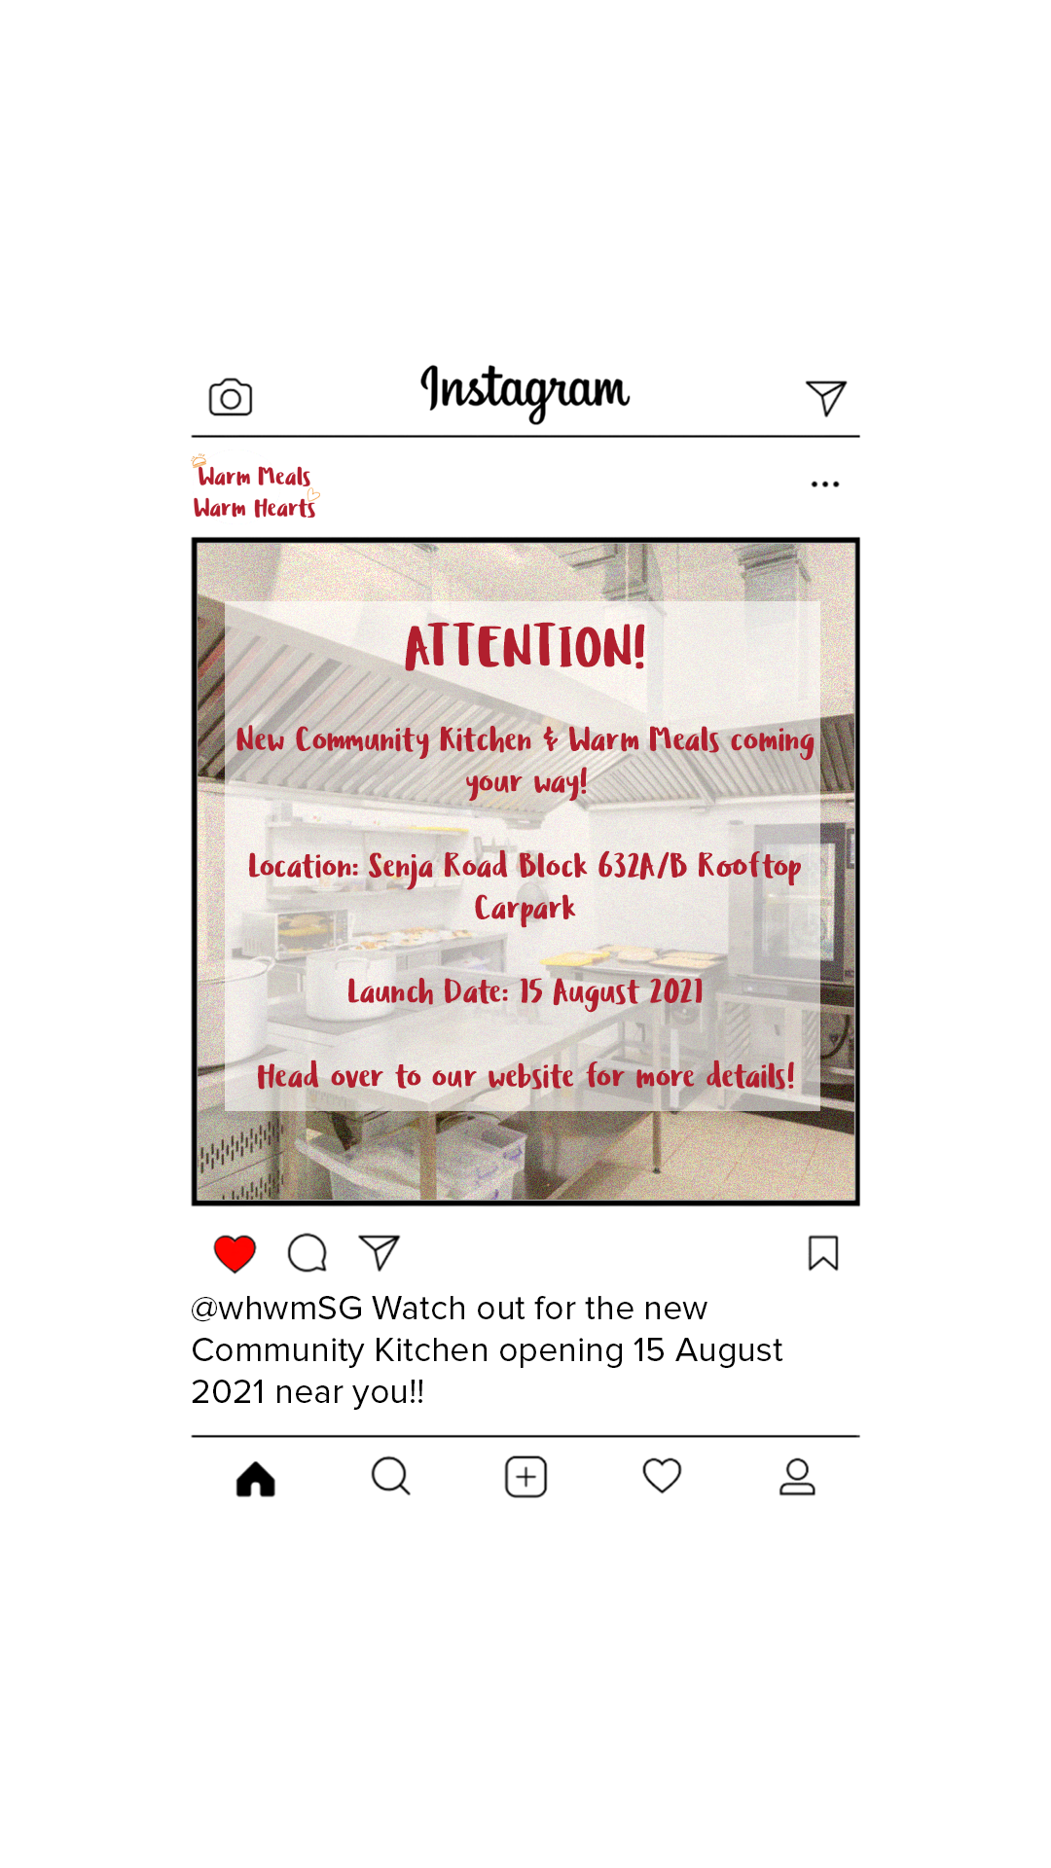

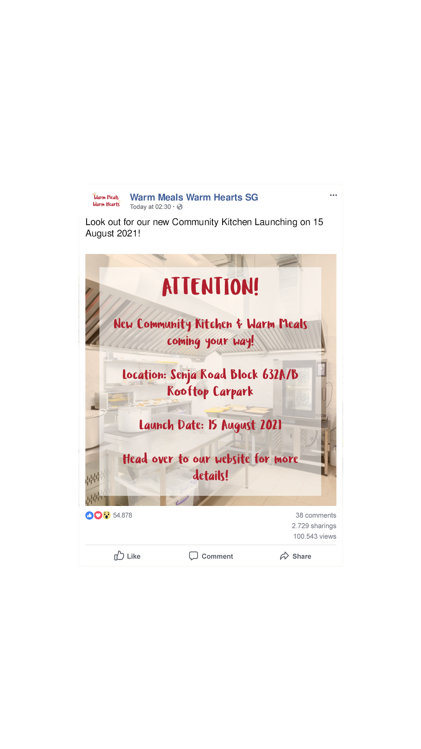
4.0 Execution Plan – Proposed Marketing Efforts
In marketing our programme, we will mainly employ door-to-door promotions alongside social media updates. There will be no need for any media buys as we are reaching out to a limited group of audience that is accessible to us
For our door-to-door promotions, volunteers will approach residents during non-peak hour timings (i.e., 9AM – 11AM, 2PM – 5PM, 7PM – 9PM) to share the details of our programme by passing out promotional flyers (Fig 4.1). This will start in May and we will cover most of the residents come July.
Fig 4.4 Instagram Post
For our social media efforts, we will set up a Facebook and Instagram page, posting the relevant details and updates of our programme (Fig 4.2 & 4.3) and showcasing Neo Garden’s participation as well.
Fig 4.3 Promotional Flyer
Fig 4.5 Facebook Post
*All marketing materials can be found in full size under Appendix B
Introduction
Situational Analysis
Reasons for Collaboration
Execution Plan
Evaluation
Conclusion

Slide 15

4.0 Execution – Proposed Execution Plan
“Warm Meals, Warm Hearts” Schedule
Week 1 | Mon | Tue | Wed | Thu | Fri | Sat | Sun
 | TMT finalises Menu | Neo Garden receives menu | Neo Garden confirms chef roster with TMT | - | Neo Garden Trial Cook | - | -
Week 2 | Mon | Tue | Wed | Thu | Fri | Sat | Sun
 | - | - | - | - | - | Actual Programme + Food Delivery | -
Fig 4.6 “Warm Meals, Warm Hearts” Bi-weekly Schedule
Time | Activity
0900 | Cleaning + Delivery
1000 | Preparation (Lunch 1)
1100 | Preparation (Lunch 1)
1200 | Distribution (Lunch 1) + Preparation (Lunch 2)
1300 | Distribution (Lunch 1) + Preparation (Lunch 2)
1400 | Distribution (Lunch 2)
1500 | Distribution (Lunch 2)
1600 | Cleaning
1700 | Cleaning
1800 | Closing
Scheduling
As shown above, we intend for the programme run on a bi-weekly schedule (i.e., 2nd and 4th Saturday every month). Preparation works such as menu finalization and chef rostering will be conducted over the week prior to the actual cooking day.
On the day of the programme, there will be 2 food distribution sessions (1200 for early lunch and 1400 for late lunch).
Menu
Food will be served in accordance with the My Healthy Plate guideline (Fig 4.4), where healthy portions of different food groups are advised for a balanced meal.
Fig 4.7 Health Promotion Board’s “My Healthy Plate”
Introduction
Situational Analysis
Reasons for Collaboration
Execution Plan
Evaluation
Conclusion

Slide 16
4.0 Execution – Proposed Budget
Fig 4.8 Kitchen Construction Budget
Item | Cost
Renovation & Construction Flooring, Ceiling, Gas, Water & Electricity Works | 30,000
Kitchen Set-Up Metal Works and Cooking Equipment | 10,000
Marketing Brochure Printing, Social Media | 1,000
Total | 41,000
Borne by:
The setup and construction of the kitchen on the rooftop carpark at Block 632A/B is estimated to cost around $30,000.
Professional cooking appliances and equipment will incur another $10,000 (Ho, 2016).
A one-time marketing effort through door-to-door promotions and social media is estimated to cost about $1,000.
*All costs are denominated in SGD
Fig 4.9 Per Cost Session Budget
Item | Cost
Raw Ingredients | 1,800
Manpower Delivery Logistics & Kitchen Management | 200
Gas & Electricity | 50
Expendables Packaging and Cutlery for 900 pax | 90
Total | 2,140
Borne by:
For each session, raw ingredients is estimated at $2 per pax (Straits Clan, 2018)
Neo Garden’s manpower costs for delivery logistics and kitchen management is estimated at $200.
Gas and Electricity for each 4 hour session is estimated at $50, with disposable food packaging and cutlery estimated at $90.
*All costs are denominated in SGD
Introduction
Situational Analysis
Reasons for Collaboration
Execution Plan
Evaluation
Conclusion

Slide 17
5.0 Evaluation – Cost-Benefit Analysis
Cost-Benefit Analysis
According to a research by Lien Centre For Social Innovation, most low-income families in Singapore experience the need to not consume a meal or go hungry for an entire day once every 12 months (Glendinning, Shee, Nagpaul, & CHEN, 2018). Our programme aims to run twice a month within the same residential area, to reduce the frequency of low-income families going hungry.
Another benefit of this programme is the environment and situation to allow for bonding between the neighbours of the blocks. Hawker Centre like settings of our programme plays which has an important role in community bonding (Kong, 2007). As such, the large costs going into setting up the physical space for this programme allow better environment for bonding between the beneficiaries of the programme.
The initial cost per meal of the programme for the first session will be 24.16 SGD however within the span of two years of the programme, the price per meal will have fallen to 2.29 SGD due to economies of scale for the initial fixed costs used to set up the kitchen. By the time this programme has reached its two-year mark in 2023, it will have costs 103,000 SGD to run but have served up 45,000 warm meals to the community, impacting the approximate 375 low-income families in the area 30 times.
$24.16
$2.29
Fig 5.1 – Price per meal over two years
By creating such an impressive impact on the lives of the community, Neo Garden can obtain positive public opinions and marketing with a diminishing cost of return in the long run, making it a cost-effective way of improving its branding.
Introduction
Situational Analysis
Reasons for Collaboration
Execution Plan
Evaluation
Conclusion

Slide 18
5.0 Evaluation – Evaluation Metrics
Metrics for measure of social impact created on the community
The goal of our programme is to forge and strengthen social bonds through food as well as creating a “Kampong Spirit” in the community. In order to measure the metrics for our goal we must look at the amount of people attending the various sessions.
The attendance rates of the sessions will help to measure the acceptability of our programme, to show if residents in the area are willing to attend such social events held within the area.
The volunteer rates of the programme are also a good measure as it can show if our programme has managed to influence more people to engage in helping their communities.
We will also be conducting a post-session survey in October of 2021, 3 months into the programme to get general feedback from the community about the programme.
How many times have you attended the “Warm Heart Warm Meals Programme?
Why have you attended/Not attended the programme?
Have you volunteered to help-out in programme?
Why have you volunteered/Not Volunteered in the programme
5. How do you find the food provided through the programme?
6. Do you think the programme has helped you in any way(s)?
7. Do you now know more people in the community around you than compared to before the programme was implemented in August?
The survey will help the team identify the effectiveness of the programme through community feed back, whether it has achieved the goals the team has intended for the programme to reach.
Introduction
Situational Analysis
Reasons for Collaboration
Execution Plan
Evaluation
Conclusion
Notes:
https://www.youtube.com/watch?v=g0iSZXyR1nc&ab_channel=OurGrandfatherStory

Slide 19
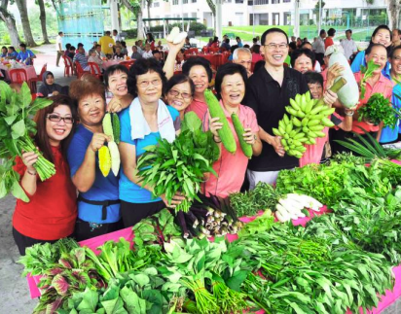
5.0 Evaluation – Long Term Plans
A. Ensuring Sustainability
To reduce the reliance on Neo Garden and TMT burden for providing for the programme. Several initiatives will be rolled out during the independent phase of the programme to alleviate to cost of the programme.
1. “Pay What You Can” Initiative
A donation box will be placed at the entrance of the kitchen and beneficiaries can choose to pay if they like to. By allowing beneficiaries to pay, also helps to give them a sense of dignity and belonging where they too have participated in their meal in some way. However, there will be no obligations to pay.
2. Donations from Surrounding Communities
Surrounding residents are also able to drop by the community kitchen to drop off their donation to show support for the initiative.
3. Donations from Bukit Panjang Community Garden
The chosen community is located near the Bukit Panjang community garden(Fig 5.2). The community kitchen will accept fresh produce (i.e. herbs and spices) from residents who are keen to donate. Depending on the amount donated, Neo Garden chefs will come up with an appropriate plan for that week.
Fig 5.2 – Bukit Panjang Community Garden
B. Expansion Plans to Other Parts of Singapore
As mentioned in the situational analysis, majority of the food insecure Singaporeans is because of the over-serving of certain communities and undeserving of other communities. Thus, the team aims to expand the scope of this project to other underserved food insecure areas in Singapore that have not been covered by food support organisations. This will likely be carried out in the expansion phase of the programme.
Introduction
Situational Analysis
Reasons for Collaboration
Execution Plan
Evaluation
Conclusion
Notes:
https://www.youtube.com/watch?v=g0iSZXyR1nc&ab_channel=OurGrandfatherStory
https://www.washingtonpost.com/lifestyle/food/inside-the-world-of-pay-what-you-can-restaurants-which-are-redefining-charity/2017/01/23/4b7b588e-d45e-11e6-945a-76f69a399dd5_story.html

Slide 20
5.0 Evaluation – Potential Challenges
Not Enough Volunteers for Cooking
Poor Reception
Dietary Restrictions of Residents
Low Levels of Enforcement
Not enough certified volunteers to help cook during the sessions. Food preparations for mass in Singapore require the cooks to be certified by the Agri-Food and Veterinary Authority of Singapore (AVA). Additionally, to provide Halal food in Singapore, there needs to be a Halal Team Leader of Muslim Representative and all involved in the cooking process must complete a Halal Training programme by an appointed MUIS-appointed training provider. As such, the number of cooks compliance with the different laws and regulations in Singapore for the programme might be limited. We can overcome this challenge by introducing a sign-up form and scheduling for the various volunteers who wish to participate and send them for the relevant training. Once they have completed their training, they will be obliged to serve the programme for a minimum of 10 sessions to cover up the costs
Low take-up rate might potentially hinder the cost effectiveness of the project. Residents around the area might be sceptical about the legitimacy of the programme and not turn up. This can result in a lot of wasted food and other resources during each session. We can overcome this challenge through our marketing efforts to boost the acceptance rate of the programme. Invite prominent public figures to come promote this social programme as well (MPs, grassroot leaders)
Dietary restrictions of various residents in the area such as allergies, religious practices and personal choices might cause the food provided to not be suitable for everyone in the area. To counter this, we can do a general survey to the people in the area and using the data, identify a set of preparation guidelines that is able to serve the majority of the people in the area.
This programme requires the residents of the area to have a high levels of consideration to each other, to only take what they need and not hog the limited food that we are going to be giving out. It is beyond our control to enforce this as the programme wishes to instil a “Kampong Spirit” within the community. However, we can put up signages and posters to remind residents to be considerate and only take what they need.
Introduction
Situational Analysis
Reasons for Collaboration
Execution Plan
Evaluation
Conclusion

Slide 21
6.0 Conclusion
In this report, TMT proposed a collaboration with Neo Garden to implement a Community Kitchen initiative for the food insecure and underserved residents staying in Senja Road. We hope the proposed community kitchen will rekindle the kampong spirit among residents, serve underserved and food-insecure residents, ensure that nutritious, quality and fresh food are available even to the food insecure. Last but not least, equip interested residents with culinary skills which may come in handy in the future (Fig 6.0).
In the short term, we hope to build up the capabilities of the community kitchen. The residents of Senja Road will serve as a testbed for the programme.
In the long-term, various measures will be in place to ensure its sustainability. The success of the programme will provide significant gains to the community in Senja in terms of skills, sense of belonging, and being food secure. This success will also contribute towards future similar projects to improve food insecure communities, where the initiative can be expanded to other underserved food-insecure areas of Singapore.
We sincerely wish that Neo Garden will join TMT in this change making journey to bring people together and to bring joy to the people. Neo Garden’s role in ‘Warm Meals, Warm Hearts’ will be a valuable contribution towards the underprivileged residents. If the team has any further clarifications, feel free to reach the TMT team at warmmeals@TMT.com.
Community Kitchen
Rekindling Kampong Spirit
Alleviating Food Insecurity for Underserved Food Insecure Singaporeans
Nutritious, Fresh & Variety of Food Choices
Teaching Culinary Skills
Short Term
Long Term
Build Up Community Kitchen Capabilities
Ensure Sustainability
Expand to other underserved areas of Singapore
Fig 6.0 – Summary of Report
Introduction
Situational Analysis
Reasons for Collaboration
Execution Plan
Evaluation
Conclusion

Slide 22
Bibliography
Alexander, L. (2020, June 03). Addressing Hidden Hunger in Singapore. Retrieved from The Borgen Project: https://borgenproject.org/hunger-in-singapore/
Au-Yong, R. (2017, September 28). Less kampung spirit and vibrancy in newer towns? The Straits Times. https://www.straitstimes.com/singapore/less-kampung-spirit-and-vibrancy-in-newer-towns
Carlson, N. (2019, June 10). Why Giving Back Increases Brand Loyalty. Retrieved from Forbes: https://www.forbes.com/sites/theyec/2019/06/10/why-giving-back-increases-brand-loyalty/?sh=56c52abe70d2
Chia, J. (2018, Aug 9). Retrieved from https://www.channelnewsasia.com/news/commentary/singapore-kampung-spirit-not-a-wish-to-revert-to-the-past-10592846
Chua, B. H. (1994). That imagined space : nostalgia for the kampung in Singapore. Singapore: Department of Sociology, National University of Singapore.
Glendinning, E., Shee, S. Y., Nagpaul, T., & CHEN, J. (2018). Hunger in a food lo Hunger in a food lover's paradise: Understanding food insecurity adise: Understanding food insecurity. Singapore: Lien Centre for Social Innovation.
Gregersen S C., Gillath O. (2020, August 1) How food brings us together: The ties between attachment and food behaviors. Retrieved from: https://www.sciencedirect.com/science/article/abs/pii/S0195666318312923
Ho, T. (2016, August 31). How Much Does It Cost To Run A Hawker Stall In Singapore? Retrieved from Dollars and Sense: https://dollarsandsense.sg/how-much-does-it-cost-to-run-a-hawker-stall-in-singapore/
Kong, L. (2007). Singapore hawker centres : people, places, food. Singapore: National Environment Agency.

Slide 23
Bibliography
Lagman, M. (2019). 5 Factors that are Killing HDB’s “Kampung Spirit”. Retrieved from 99.co: https://www.99.co/blog/singapore/5-factors-that-are-killing-hdbs-kampung-spirit/
Liang, W. W. (2019). Making of a "kampung spirit" in modern Singapore. Singapore: Nanyang Technological University, School of Social Sciences.
Ng, D. (2018, November 20). Profit margins for hawker fare? As low as 20 to 30 cents. Retrieved from Channel News Asia: https://www.channelnewsasia.com/news/cnainsider/profit-margins-for-hawker-centre-fare-as-low-as-20-to-30-cents-10948414
Seemann, A., Hardcastle, D., Diers, D., & Han, J. (2021, March 01). The Expanding Case for ESG in Private Equity. Retrieved from Bain: https://www.bain.com/insights/esg-investing-global-private-equity-report-2021/?utm_source=linkedin_company&utm_medium=social_organic&utm_content=4548221592&utm_campaign=OS-PE-PEG-GLOBALPRIVATEEQUITYREPORT-2021-03&linkId=112742648
Straits Clan. (2020, April 4). Straits Clan Community Kitchen — FAQ. Retrieved from Straits Clan: https://straitsclan.com/communitykitchen-faq
Sam Jo, Y. (2016, March 21). Voiding the kampung spirit?, ST Editorial News & Top Stories - The. The Straits Times. https://www.straitstimes.com/opinion/st-editorial/voiding-the-kampung-spirit
Tong, G. C., Yip, C., & Tiah, C. (2020, February 23). Pulling together in creative ways, to better feed food insecure Singaporeans. Retrieved from Channel News Asia: https://www.channelnewsasia.com/news/cnainsider/food-insecurity-hunger-singapore-charity-donations-taskforce-12460350

Slide 24
Bibliography
Tong, G. C., Yip, C., & Tiah, C. (2020, February 16). Why in a cheap food paradise, some Singaporeans are still going hungry. Retrieved from Channel News Asia: https://www.channelnewsasia.com/news/cnainsider/food-insecurity-singapore-hunger-poverty-12438646#:%7E:text=Locally%2C%20a%20study%20conducted%20by,severe%20food%20insecurity%20in%202018

Slide 25
Appendix - A
Primary Research: Pre-Survey
What is your household Per Capita Income?
Number of Respondents: 30
What kind is in your food aids/ food assistance package, if you and your neighbors received any?
How often are cooked food or meals distributed to you and your neighbors?

Slide 26
Appendix - B
Marketing Efforts: Facebook & Instagram Posts
Promotional Flyer
Example of Facebook Post
Example of Instagram Post

